Slide 1
The Digital Dictionary of Buddhism [DDB]: A Model for the Sustainable Development of a Collaborative, Field-wide Web Reference Service
DH 2011
@
Stanford University
June 19-22, 2011
Charles Muller
University of Tokyo
Center for Evolving Humanities
Notes:
Good morning, and my deepest thanks to all of you who have made it here for this early morning meeting.
First, I would like to mention that in the 15-odd years now that I've been making presentations on this project, this is the first conference or symposium where there was another project of this genre on the program: That is, a collaborative scholarly effort toward the creation of an online reference service that attempts to provide exhaustive coverage of a specific field. I am speaking here of yesterday’s presentation on the extremely promising Encyclopedia of Egyptology. Thus, I am delighted to know of at least one more work that begins to fill the vast space between published-for-profit online reference works, and Wikipedia-like free-for-alls (in every sense of that expression) -- that is online reference works built and maintained through the collaboration of academic specialists in a given field, whose primary purpose is the dissemination of rigorously accurate, responsible, properly accredited information, that does not have financial profit as a major goal.
After yesterday’s presentation I also realized that I should point out that the word Dictionary as being used here today is a translation of an East Asian concept called Jiten, which in Western terms might be described as a sort of hybrid dictionary and encyclopedia, as our dictionary is has numerous long articles contained within.
In today’s presentation, I don’t intend to go too deeply into the technical aspects of the project, which, being an XML based database running on Perl and XSL are not especially distinctive (although we are quite proud of the elegant and transparent simplicity of its functions). Instead, I’d like to talk about the management strategies that we’ve developed mostly through trial and error that have led the project to its predominant status in its field today, and which seem capable of ensuring continued steady growth into the foreseeable future.

Slide 2
Why Are There So Few Comprehensive “Field Reference Services”?
Joseph Raben: “Humanities Computing in an Age of Social Change,” Keynote Lecture, Digital Humanities, King’s College, 8th July 2010:
“It seems ironic that the community of scholars dedicated to promoting wired access to the riches of the humanist tradition have so far failed to create a Wiki of their own activities. To rely on the imprecise algorythmic methods of Google, which is basically an advertising medium designed by computer engineers without any evident input from the scholarly community, scarcely seems like appropriate behavior for a group that prides itself on the minute accuracy of its own documents. . .“
Notes:
While from one perspective, many users of digital resources may be impressed by the development of new tools, from another perspective, one might say that the academy has been both ignorant and negligent regarding the role that it should be playing in providing online knowledge, having unintentionally turned the responsibility for the handling of the world’s humanistic knowledge over to Google, Wikipedia, and various other non-scholarly organization. {Next slide} This situation is being sharply criticized by some leaders in the field of Digital scholarship, including people such as Joe Raben, who focused on this negligence in his keynote lecture at DH 2010 last year.

Slide 3
Raben, continued:
“. . .And while Wikipedia probably contains a good deal of information regarding Digital Humanities, that information is so scattered among all the other types of information it contains, and is so subjected to random editing that it cannot be relied on for comprehensiveness, interconnectivity, or timeliness. . . ”

Slide 4
Why Are There So Few Comprehensive “Field Reference Services”?
Jaron Lanier: (You Are Not A Gadget) :
Lanier tracked a broad range of scholarly reference web sites, and reported that virtually all of them either stopped growing, or disappeared entirely after the emergence of Google, Wikipedia, and related technologies.
Notes:
Most of you are also probably familiar critiques by Jaron Lanier (known as the father of Virtual Reality), who has strongly articulated his concerns about the atrophy of responsibly-authored reference sites, and the scary rise of the prominence of the “hive mentality” on the Web since the flourishing of Wikipedia and Google. But Lanier’s answer to this problem, like that of Joe Raben—and I would I think I can include myself and the Egyptology team here—is not to sit around and bemoan or criticize these organs of information gathering, but to reflect on ourselves and make our own effort, and take our own responsibility to offer a better alternative.

Slide 5
Introducing the Digital Dictionary of Buddhism (DDB) (and companion CJKV-E Dictionary)
The DDB is a . . .
Comprehensive (55,000 entries), collaborative, online reference work, edited by academic specialists in the field of Buddhist Studies.
Online since 1995, it achieved broad recognition as a leading field reference work around 2003.
Now cited regularly in scholarly works, and subscribed to by over 40 major university libraries
Features state-of-the art backend technology seen in its (TEI-influenced)-XML, XSL, indexing, search and delivery functions.
Notes:
In addition to the various topic indexes, you can search via Chinese, Japanese, Korean, or through dedicated indexes of the romanized versions of those languages, both with and without diacritics. Most users search through canonical East Asian languages, but there is no problem going through English {search a word}.
Data nodes provide direct information on editorial responsibility and sources. Each entry also provides a list of other references that contain information on the given term, with page numbers.
The XML source is also available for those who are interested.

Slide 6
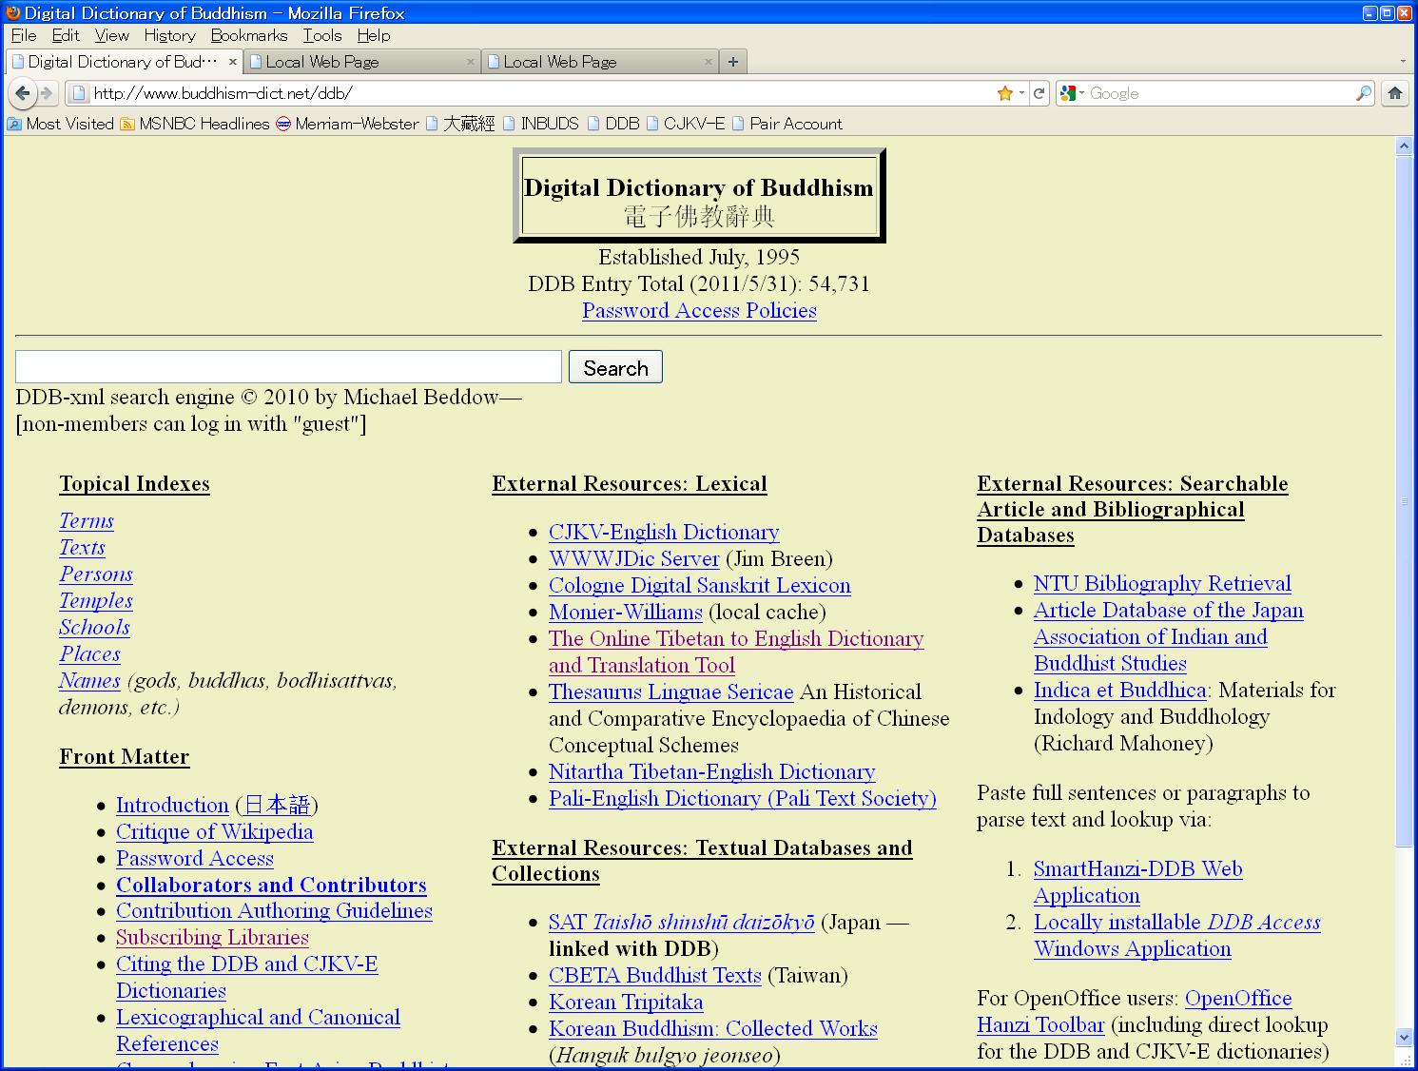

Slide 7
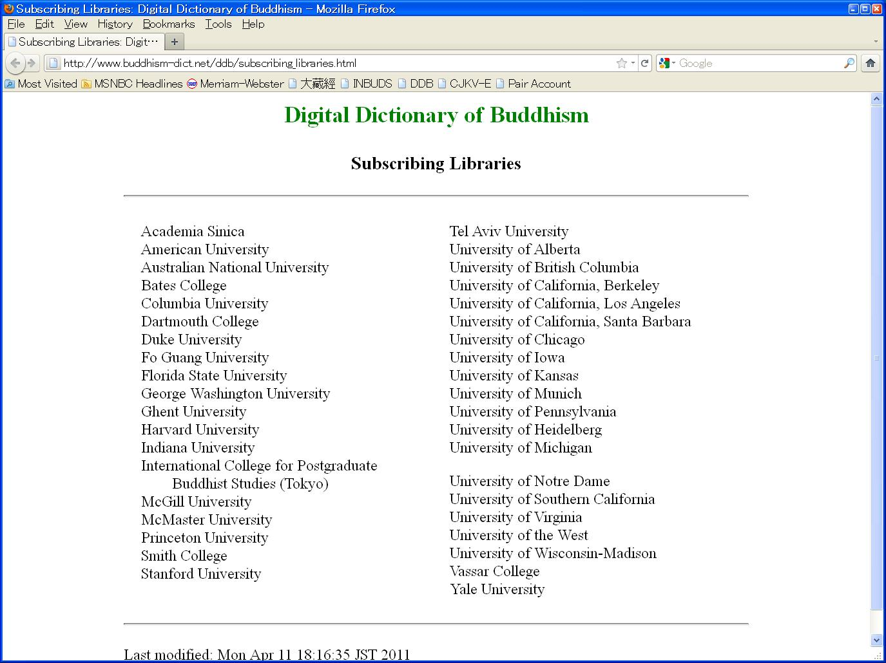

Slide 8
Usage by Scholars
Nowadays, the DDB is used as a reference tool by students studying Buddhism at such schools as Stanford, UC Berkeley, UCLA, Harvard, Yale, UVa, Michigan, Princeton, Columbia, and virtually all other major universities in North America and Europe that have programs that include the study of Buddhism in a significant manner.

Slide 9
Collaboration by Scholars
Content is edited by more than 70 scholars, including a substantial contingent of noted field leaders, whose contributions are clearly documented and displayed.
The technical structure and function of the DDB is administered by specialists in XML and related technologies, with the primary framework and delivery handled by Michael Beddow.
Notes:
The “collaborators” in the left are people who have made massive and/or ongoing contributions.
Originally the left-side column used to list area editors; but since none of them edited their areas, which changed this column to reflect the differences in significance of contributions.
The right side lists our technical collaborators, and all three columns are arranged in approximate descending order of size or significance of contributions.

Slide 10
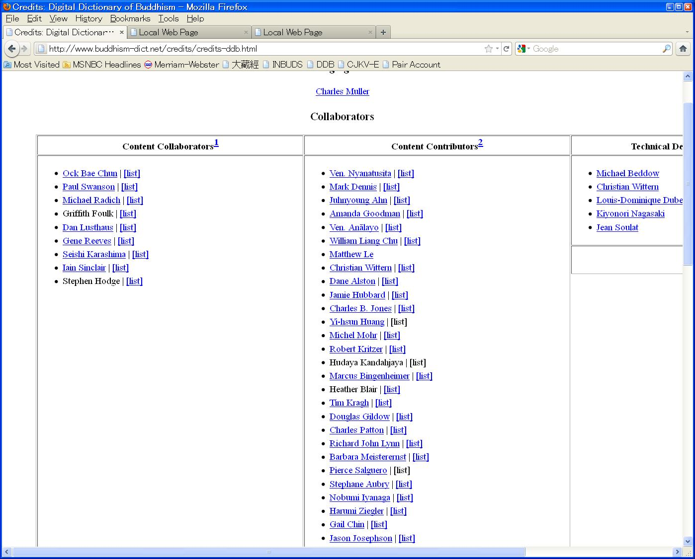

Slide 11
Early Developments
1986 – work initiated with book publication in mind.
1995 – placed on web with approx. 2800 entries, in simple HTML hardlinked format, envisioning the framework of a heretofore unimagined collaborative project.
1998- Conversion of source data to XML
2001 – Michael Beddow creates real Web search delivery with Perl/XSL (approx. 5,000 entries)

Slide 12
Building of Critical Mass
2002 – Completed input of digitized materials from a major copyright-expired reference work on Buddhism (Soothill’s Dictionary of Chinese Buddhist Terms) (funded by JSPS), and along with my own input, raised the DDB content to 15,000 entries, thus creating a respectable basic range of coverage.

Slide 13
What? No Contributions?
But despite the extensive volunteer efforts of Michael and myself to offer all this material for free with the hope of stimulating collaboration, as of 2002, despite our strongly-expressed requests for contributions from scholarly users, except for a very small handful of forward-thinking scholars, we were receiving almost no contributions. Yet, we had clear numerical data and anecdotal information that this resource was now being used extensively for teaching and research by many scholars in our field.

Slide 14
Getting Mean: Carrot/Stick Access Policies
We thus began to experiment with leveraging the password policy (which had originally been set up only for security) to establish a two-tiered access structure: member/guest.
We started out giving guests 50 searches a day (which they were all quite happy with), then gradually decreased the number in increments of 10 until people began to scream—at which point we knew we had the right number (10 daily searches). And so, we began to tell them . . .

Slide 15
“If you want full access, you have to contribute, one way or another”
For qualified scholars, one A4 (letter) page of data for two years of full access. Actually, quite small, but the aim, which has been successful, is to create a sense of being a collaborator rather than a simple “user.”
A surprising number of highly-respected scholars began to operate in a way that they never had before, and even began to develop a sense of pride and belonging in being part of the project.
To meet the demand for non-scholars who wanted access, we offered the option of subscription at $30 per year. University libraries at $250 (cheap, I am told). Now we had a small, but steady income that we used for creating and adding new data, and thus the size of the database continued to grow faster and faster, and this continues to be the case up to today.

Slide 16
The final critical element: broadcasting credit
Numbers and quality of the resource alone do not make for project success: Communication, especially regarding the contributions of scholar-members, is of critical importance.
Success of the model is based greatly on devoting energy to making known the contributions of collaborators: node level, web site (Contributors), monthly newsletter, monthly data postings.

Slide 17
Major Leap Forward: Interoperation with SAT Online Text Database
2008 – For the first time, the DDB was applied directly to an online canonical text database, based on the work of Kiyonori Nagasaki of IIDH.
2008 – Reverse linking: based on documentation provided on the SAT web site, we were also able to link entries directly back into their locations in the Taishō via SAT.

Slide 18
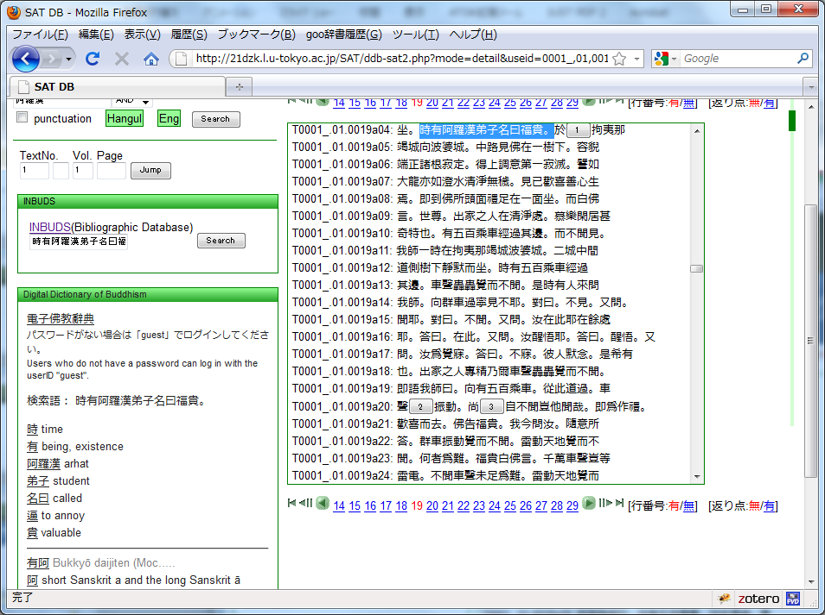
Select a portion of text
Basic meanings from DDB, along with a link into the dictionary are generated
Notes:
Next, if the user selects a portion of the text with his or her mouse, a list of terms within that text that are contained in the DDB, or in a larger master index is generated on the left.
If you click on one of these terms, you can go directly to its entry in the DDB.

Slide 19
Is this Model Replicable? Basic Requirements
A small, but dedicated team of capable editors, with a clear goal in mind.
Ongoing technical support. Today, relevant CMS and people with DH programming know-how are in far great abundance than they were when we started the DDB.
An initial startup grant to create enough critical mass to draw attention away from competing nonscholarly agglomerations..

Slide 20
Thank you!
恕
[ “reciprocity”]

